Slide 1
Human 2.0
presented by Armin Schneider

Slide 2
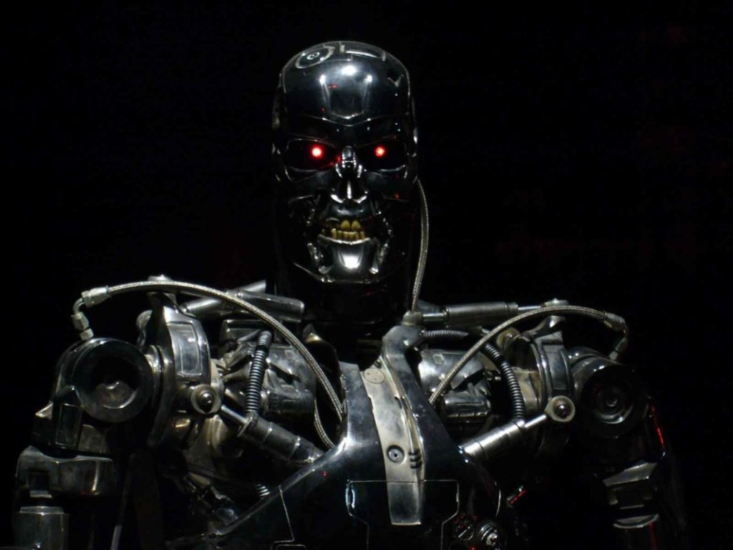
Overview
Who is Ray Kurzweil?
Are we merging with technology?

Slide 3
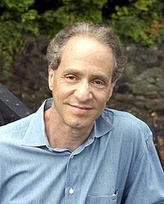
Ray Kurzweil
Born in: February 12, 1948 (age 74)
Inventions:
  optical character recognition
  speech recognition
Books:
  “The Singularity is Near: When Humans Transcend Biology”
  “The Age of Spiritual Machines”
2005

Slide 4
Are we merging with technology?
Controlling machines with your mind
Paying with an “in-built” chip
Being stronger, faster and “repairable”

